Slide 1
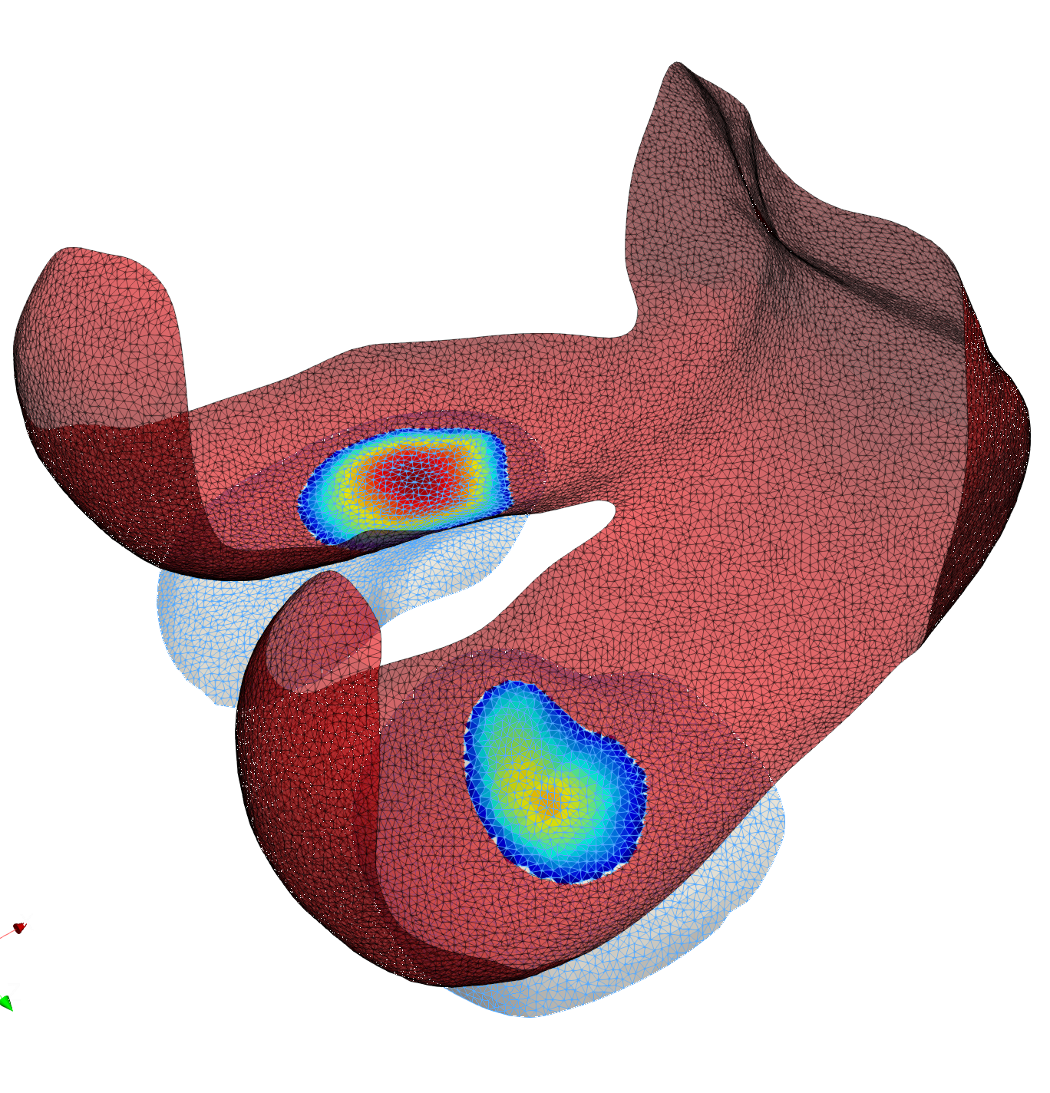
Normal
Center
Tibia
casting_mesh
Femur
target_mesh

Slide 2
Normal
casting_mesh
Proximity
target_mesh

Slide 3
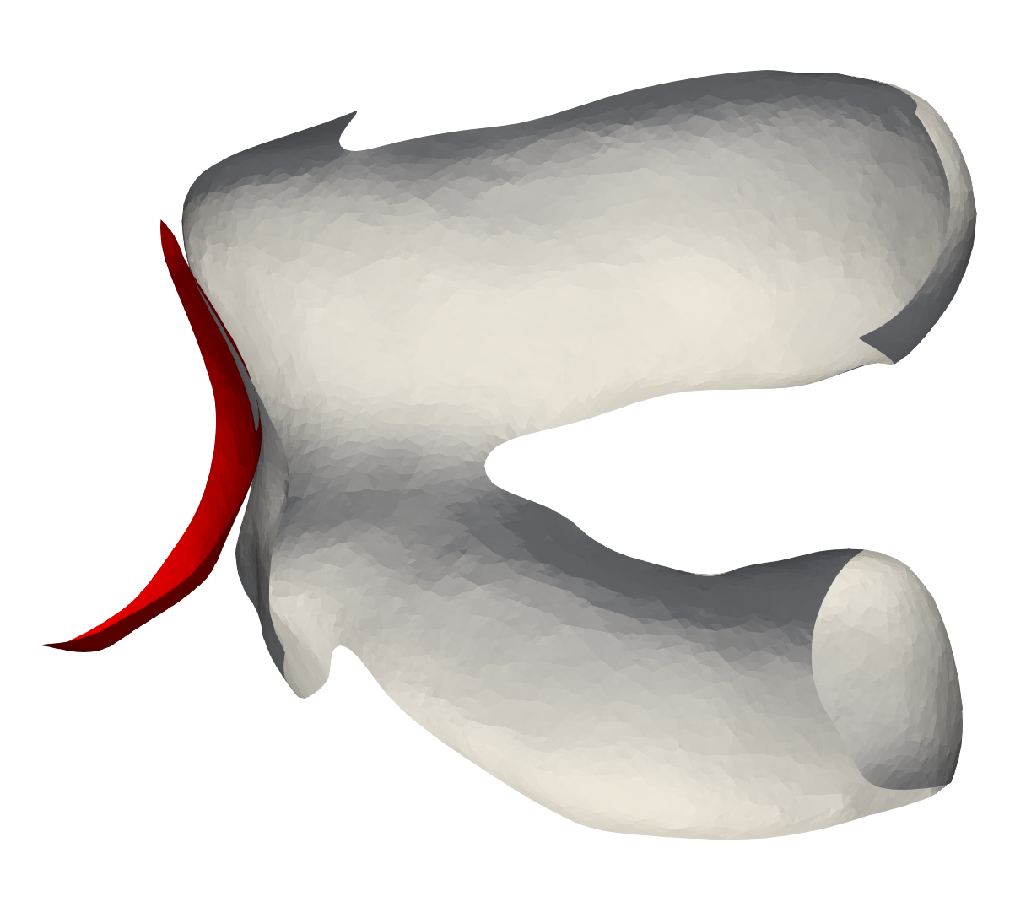

Slide 4
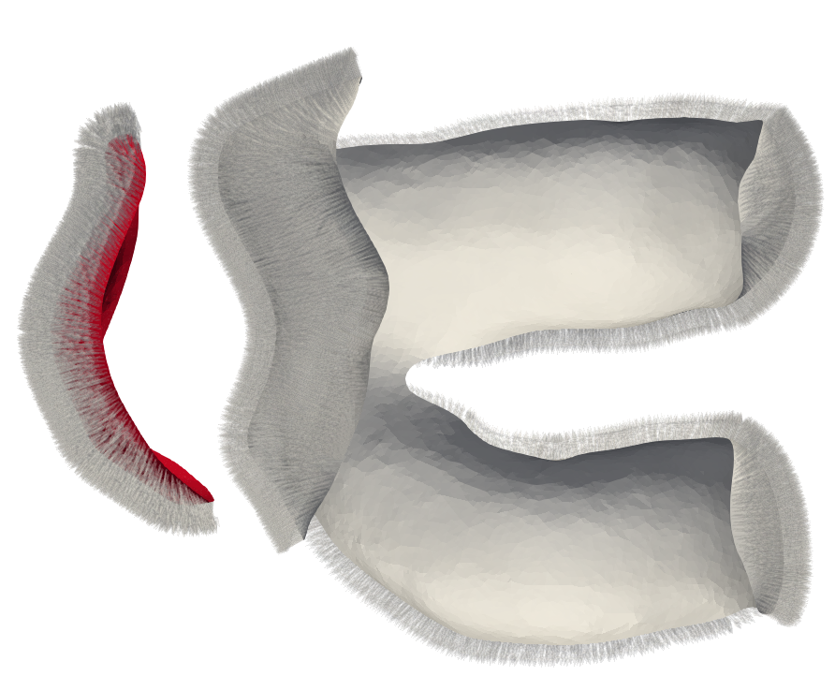

Slide 5
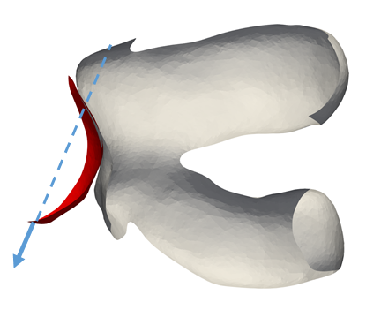

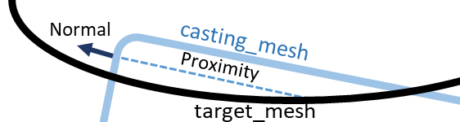
Case 1
Case 2
Case 3

